Slide 1

AI BASED INTERVIEW FACILITATOR APP V2
UM-E-AIMEN (FA21-BSE-038)
DAUD RAZZAQ (FA21-BSE-112)
IBRAHIM KHAN (FA21-BSE-096)
Supervisor: Ma’am Bushra Mushtaq
Department of Computer Science
COMSATS University Islamabad, Abbottabad Campus

Slide 2
Agenda of the Presentation
Motivation
Introduction
Scope
Key Functionalities
Tools/Techniques
Feasibility Analysis
Gannt Chart
First Iteration 30%
Final Thought

Slide 3
Motivation
The AI-Based Interview Facilitator App idea comes from the limitations in traditional and remote interview methods, which often miss critical non-verbal cues and can be biased by human judgment.
Previous app version lacked the functionality of online interviews and relied on inconsistent question generation.

Slide 4
Brief Introduction
The AI-Based Interview Facilitator will improve traditional interviews by generating related pool of questions , based on extracted information from candidates' CVs and targeted job type.
The pool of questions will include candidate’s education, experience, skills, and interests.
The app will also support remote interviews, providing real-time monitoring of facial expressions, eye contact, and signs of distraction.

Slide 5
Scope
Our app will:
Use machine learning model to generate questions based on the candidate’s CV and targeted job type.
Support both in-person and remote interviews.
Provide real-time monitoring of verbal and non-verbal cues in case of remote interviews.
Criteria-based response evaluation and marking.
Real time report generation and dispatching to relevant authorities.
In live interviews will support only one speaker(interviewer/candidate) at a time
Will only support English language.

Slide 6
Functionalities/ Modules
1. CV Data Extraction
2. Candidates Data Management
3. Role-Relevant Question Generation
4. Dynamic Follow-Up Question Generation
5. Real-Time Transcription
6. Non-Verbal Analysis
7. Report Generation
8. Data Security and Access Control

Slide 7
Proposed Tools/Platform
Technology | Version | Rationale
Llama 8B instruct | 3.1 | Generate questions
Assembly AI | latest | Audio to text
OpenCV | latest | FER
React Native | latest | Programming language
Flask(Python) | latest | Framework
Figma | latest | User Interface
Report/Presentation | Microsoft365 | Documentation
Firebase | latest | Database
Visual Studio | latest | IDE
GitHub | latest | Version control

Slide 8
Feasibility Study: 1. Technical Feasibility
Tools | Availability
NLP frameworks (Llama) | Yes
OCR | Yes
Real time monitoring(Open CV) | Yes
React Native TTS | Yes
React Native STT | Yes

Slide 9
2. FINANCIAL FEASIBILITY
Hardware/Software Tools | Cost
OpenCV | Free
OCR(Optical Character Recognition) | Free
React Native TTS, STT | Free
NLP(Llama) | Free

Slide 10
3. RESOURCE FEASIBILITY
Resources | Availability
Software Tools/IDEs | Yes
Development Team | Yes
Time | Around 10 months

Slide 11
4. Operational Feasibility
After the release of the system, it will be used by:
Interviewers
Acts as a helper for the interviewer and provide a structured road map for the interview.
Will provide an unbiased and fair environment for candidates
For candidates it is required to have a mobile phone with a Microphone and camera.
Transcription will be time-saving for the process.
Internet availability is also required.

Slide 12
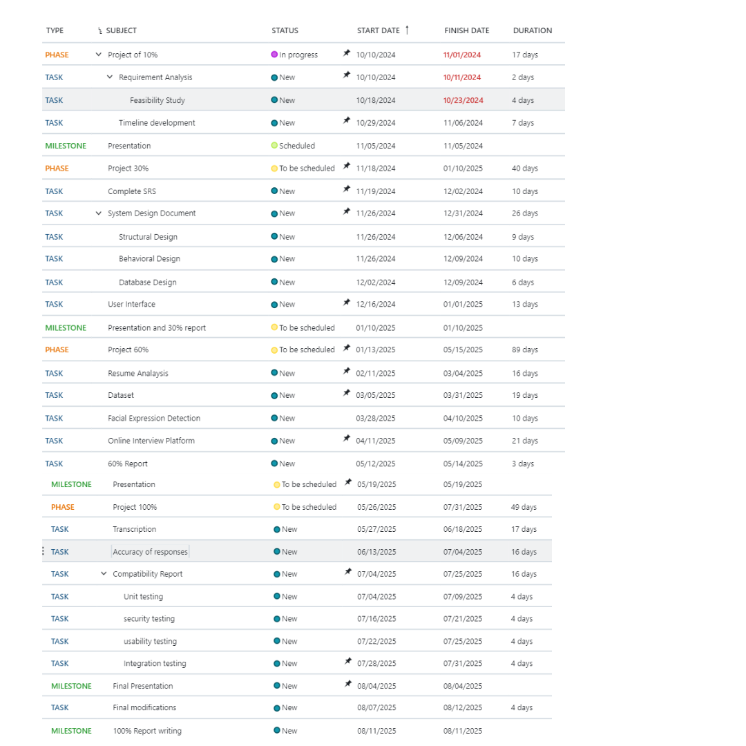
Schedule

Slide 13
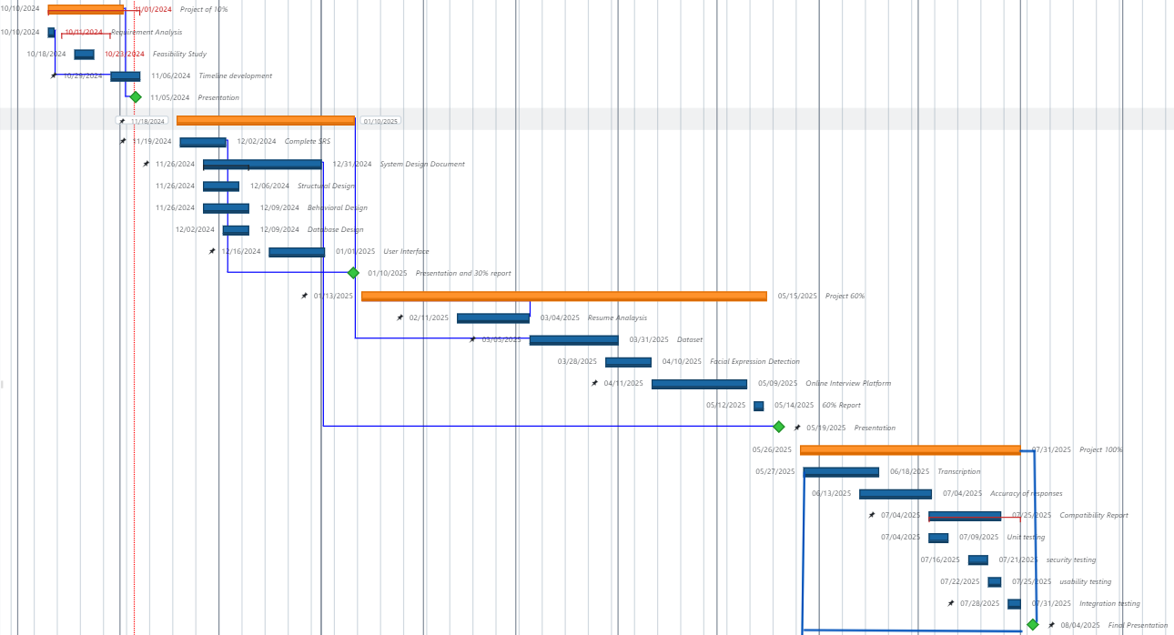
Gantt Chart

Slide 14
Tasks for 1st Iteration (or 30%)
Software Requirement Specification
Software Design Document
Front-End
Presentation and 30% Report

Slide 15
Final Thought
In summary, our application is designed to make interviews smoother and more effective. It will create personalized questions, analyze candidates' responses and expressions in real time, and generate insightful reports.
This system provides a fair way to evaluate skills, track engagement, and give quick feedback, helping recruiters make unbiased and efficient hiring decisions.

